Slide 1
High Availability Design
Lets look at various HA designs

Slide 2
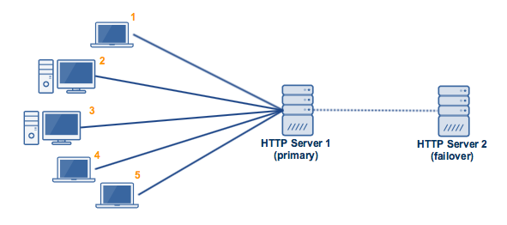
High Availability Design
ACTIVE-STANDBY SERVER CONFIGURATION
https://www.getfilecloud.com/blog/2015/12/architectural-patterns-for-high-availability/#.WVeex4SGPIU

Slide 3
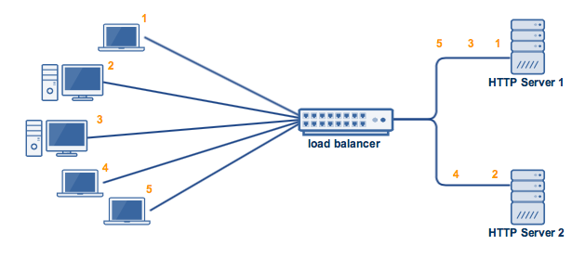
High Availability Design
ACTIVE-ACTIVE SERVER CONFIGURATION
https://www.getfilecloud.com/blog/2015/12/architectural-patterns-for-high-availability/#.WVeex4SGPIU

Slide 4
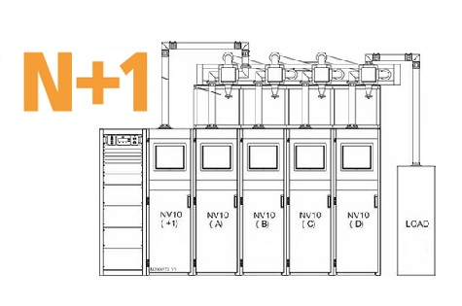
High Availability Design
N+1 UPS REDUNDANT CONFIGURATION
https://www.getfilecloud.com/blog/2015/12/architectural-patterns-for-high-availability/#.WVeex4SGPIU

Slide 5
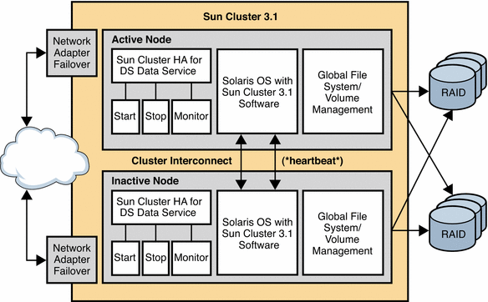
High Availability Design
ACTIVE-STANDBY SUN SERVER CLUSTER
https://docs.oracle.com/cd/E19693-01/819-0992/6n3cn7p3n/index.html

Slide 6
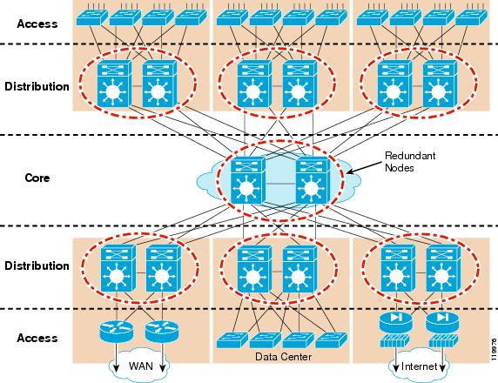
High Availability Design
NETWORK REDUNDANT CONFIGURATION
http://www.cisco.com/c/en/us/td/docs/solutions/Enterprise/Campus/HA_campus_DG/hacampusdg.html

Slide 7
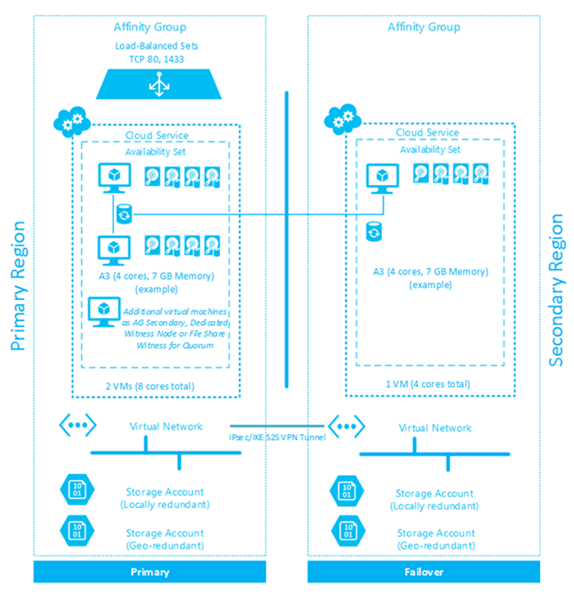
High Availability Design
DATA CENTER REDUNDANT CONFIGURATION
https://www.getfilecloud.com/blog/2015/12/architectural-patterns-for-high-availability/#.WVeex4SGPIU

Slide 8
High Availability Design
Don’t forget to test the failover and fault tolerant capabilities of our network

